Slide 1
DEVELOPMENTS IN THE PAYMENT AND SETTLEMENT
18th SAARC Payment Council Meeting
13 August 2018
Maldives Monetary Authority

Slide 2
CONTENTS
Recent Developments
Payment System Statistics
Challenges in the existing payment infrastructure
Future Plans

Slide 3
RECENT DEVELOPMENTS
CHEQUE IMAGING AND TRUNCATION
MOBILE PAYMENT SYSTEM
Cheque Imaging and Truncation System (CITS) was introduced in November 2016.
CITS allows the banks to exchange cheque images and data through the ACH
Reduces nationwide clearing cycle
Mitigates the associated risks of manual clearing
MNO-led mobile payment services was first introduced in the country in June 2016
Allows customers to register to a "Mobile Wallet Account" in order to deposit, withdraw, P2P transfers, and make bill payments
Customers are not required to have a bank account

Slide 4

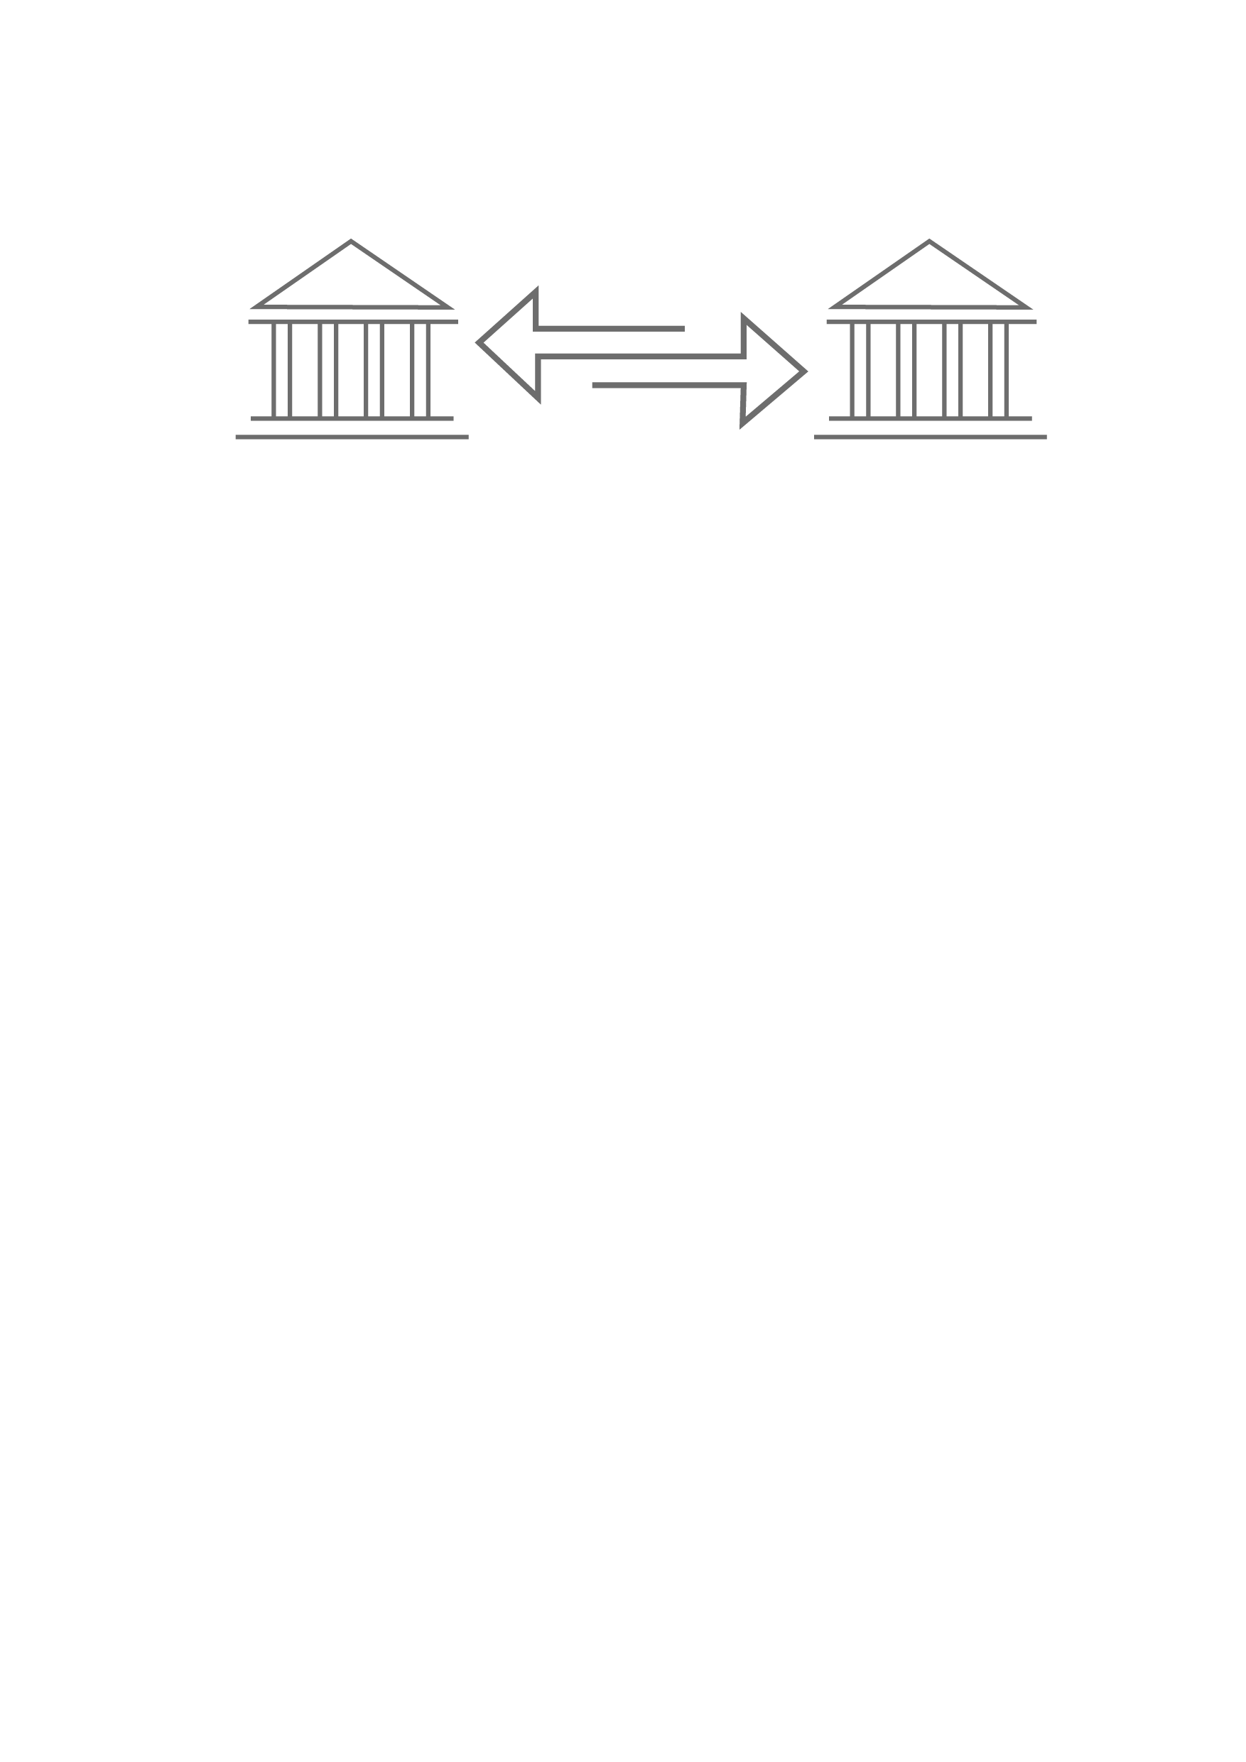
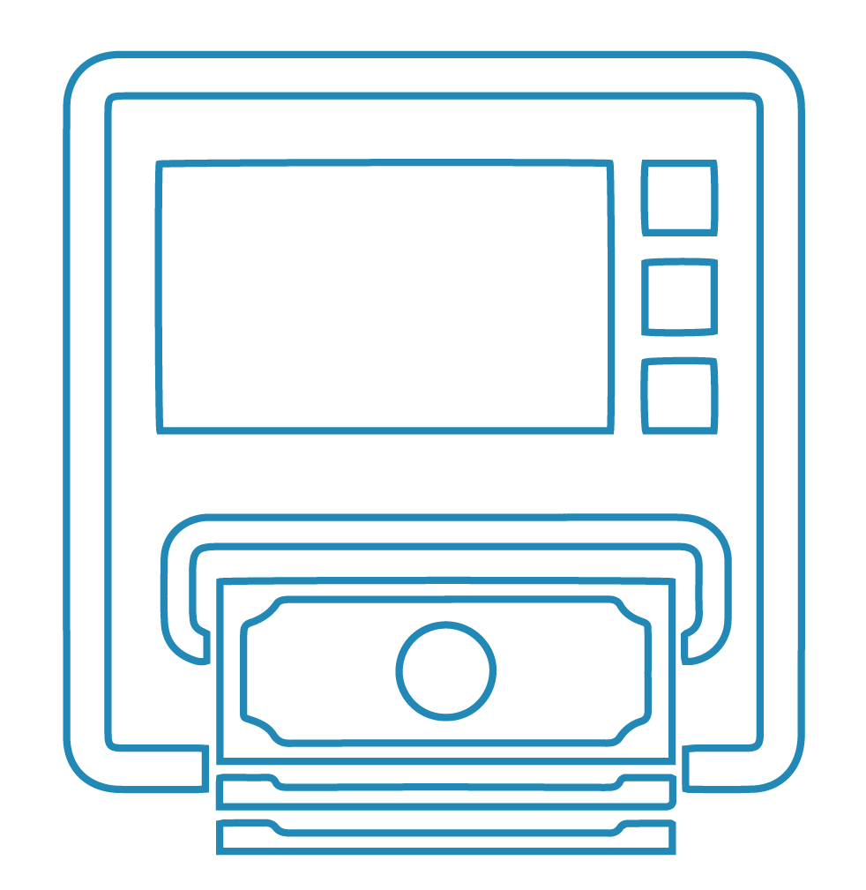


STATISTICS
Inter-bank Payments
52
Bank branches
More than 35% of bank branches and 50% of this infrastructure is based in the greater Male’ region and rest is distributed across 184 inhabited islands
116
ATMs
Card Payments
24 MILLION
TRANSACTIONS IN 2017
TOTAL VALUE OF MVR 40 BILLION
6,897
POS Terminals
Over 50% is cash withdrawal

Slide 5
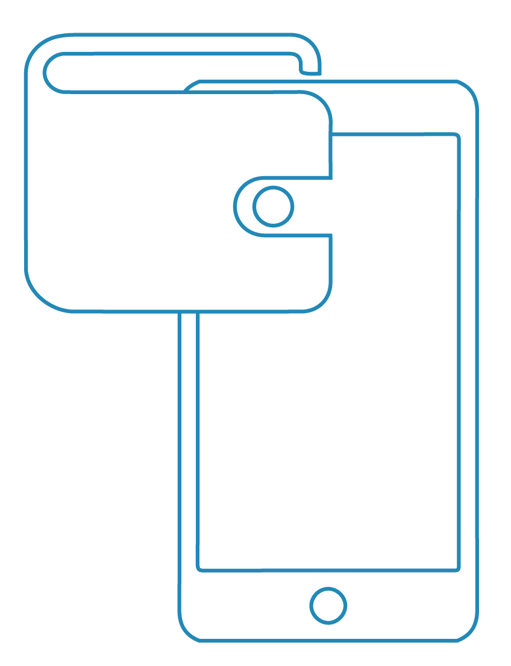




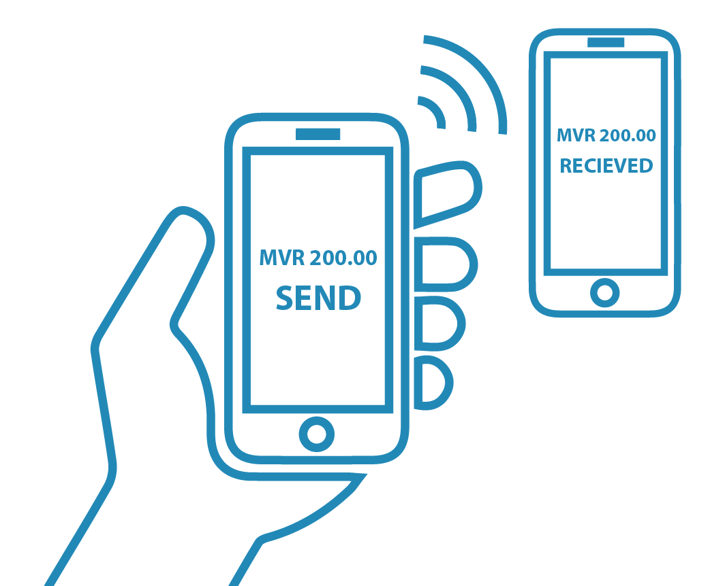
STATISTICS
Over 17,000
Mobile Wallets
Mobile Money Distribution Network
37 THOUSAND
TRANSACTIONS IN 2017
125 Agents
166 Merchants
Presence in 58 islands
45% - postpaid bill payments
Includes 37 islands that do not have a bank branch or an ATM
120 Dual Agents
38% - airtime top-ups
  17% - P2P transfers, utility bills & merchant payments
TOTAL VALUE OF MVR 12 MILLION

Slide 6
CHALLENGES IN THE EXISTING PAYMENT INFRASTRUCTURE
Closed looped system based on costly traditional banking model
Lack of integration and interoperability across banks and other payment service providers
Mobile operators are faced with challenges in linking their services with the bank accounts
Lack of ideal level of competition and shallowness of financial markets
No online mechanism to access to payment systems
Cash and cheques remains the dominant payment instrument

Slide 7

FUTURE PLANS
Initiative to transform the existing payments landscape
Establish fast, convenient, secure and reliable payment infrastructure
Implement open and flexible account based real-time payment system augmented with functionalities such as smart addressing
Aimed to enhanced end-to-end user experience while ensuring safety and efficiency
Introduce integrated solutions\to seamlessly combine the payment services and value added services

Slide 8
PROJECT UPDATE
Preliminary assessment of the existing payment systems
  Meetings with stakeholders
  Payment system surveys
Payment System Workshop
  Explore payment initiative taken by other countries
  Understand the trends in the global payment solutions
Formulating the concept for new payments infrastructure
  Obtained technical assistance from external advisors

Slide 9
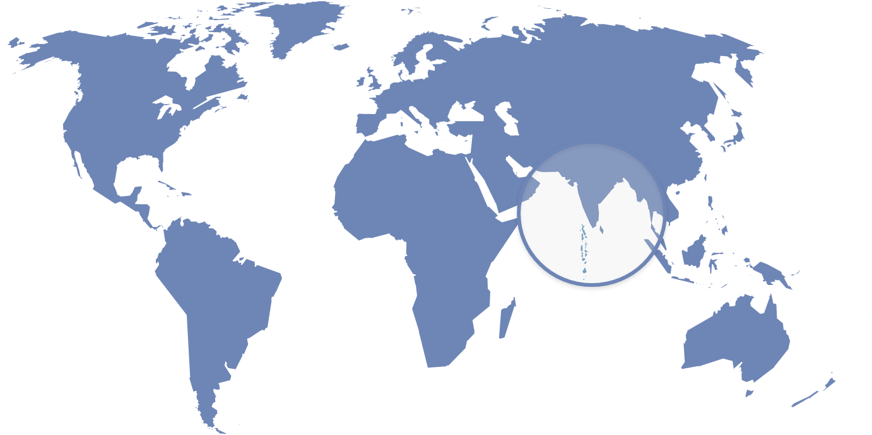
THANK YOU!

