Slide 1

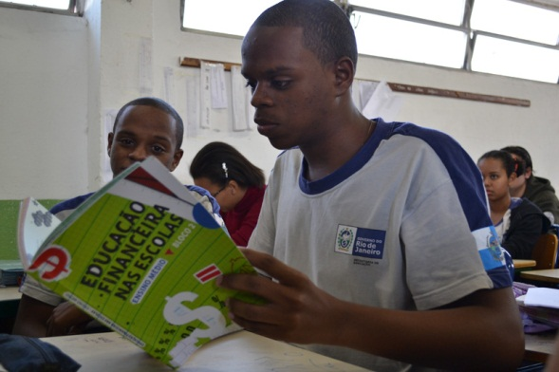
Financial Education and Behavior Formation:
Large Scale Experimental Evidence from Brazil
Miriam Bruhn
Luciana de souza leao
Arianna Legovini
Rogelio Marchetti
Bilal Zia
World Bank
New Delhi, March 5th 2013

Slide 2
Agenda
The Brazilian Financial Education in Public High Schools
Impact Evaluation: implementation and results
Positive Lessons
Policy Outcomes

Slide 3
Financial Education for High School Students
Part of the Brazilian National Strategy;
  High School program was the first to be launched.
Product of a systemic effort: complementary skills and institutional capabilities of leaders from the government, financial market and different actors from the Brazilian education sector;
Started as a pilot-project before going to a broader scale: learning experience for all the stakeholders involved.

Slide 4
The program - Pedagogical Strategies
  Teaching Material approved by a multi-stakeholders Pedagogical Support Group;
  Created to inform and guide young people to an independent and healthy financial thought and behavior;
  Books containing teaching situations aligned to the reality of the student and with autonomy for the teachers;
  It’s content can be discussed and used by any subject in the school – cross-curricular approach

Slide 5
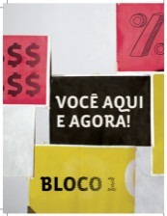

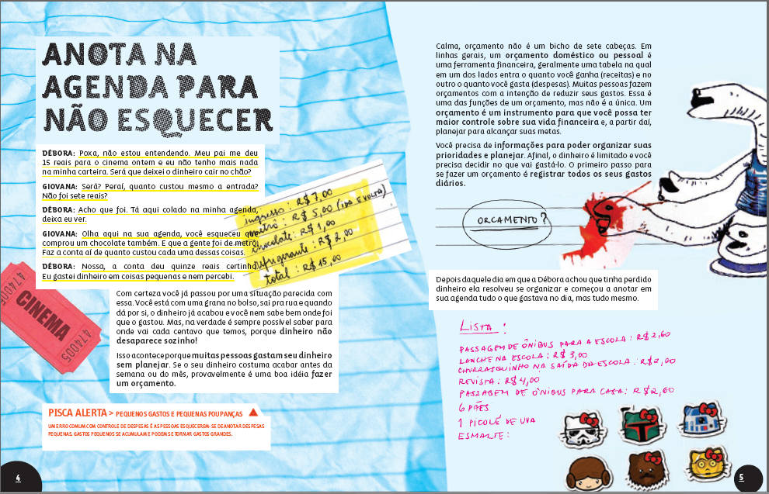
Book 1 – Short-term situations related to individual context
Book 1 - everyday family life, social life, and personal property
Keeping track of Expenses

Slide 6
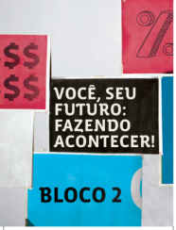


Book 2 – Medium term situations
Book 2 - work, entrepreneurship, and large projects
Which career do I want to follow?

Slide 7
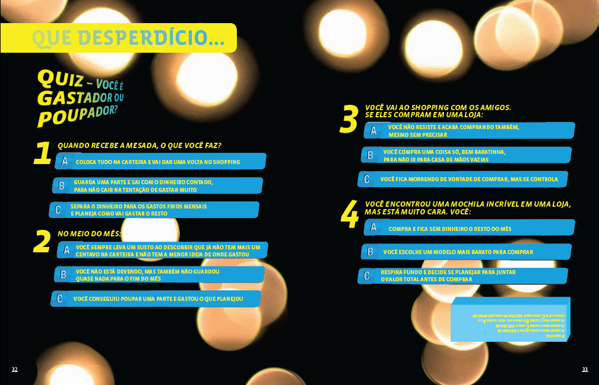
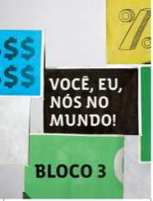

Book 3 – Social Context
Book 3 - public goods, the country’s economy, and the world economy.

Slide 8
Teacher’s training and involvement
Key aspect: convince teachers of the importance of the financial education and build trust to teach;
Training workshops in 6 states complemented by virtual training (DVDs to facilitate replication);
Teacher guidebook provided instructions on teaching and assessment methods for the course material, as well as examples of how to integrate the financial education curriculum into regular school learning.

Slide 9
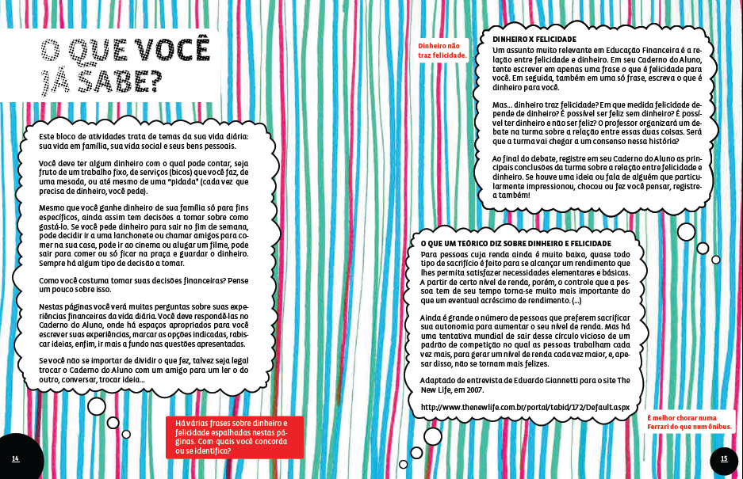
Example: How to implement a case-study?
Contar para os alunos como aprendi a tomar decisões financeiras.
Abrir debate: quem concorda / discorda da posição do autor?

Slide 10
Impact Evaluation
Collaborative work with implementation partners in all the stages of planning for the pilot project;
The study spanned three academic semesters, from August 2010 to December 2011, and data were collected in three rounds consisting of baseline (August 2010), follow-up 1 (December 2010), and follow-up 2 (December 2011);
Participation in all teacher’s training, workshops and monitoring events throughout the pilot.

Slide 11
Where Do Things Usually Break Down? (1)
Improving knowledge—many educations programs fail to increase knowledge
How did the project address this problem?
  Quality: material developed by top education experts in Brazil and rigorously tested
  Use: training and materials provided to all teachers
  Incentives: opportunity for teachers to meet leaders in the financial and international institutions, and awards to best performing schools
Effect: rethink high school education
  Fun, relevant, interactive, proactive

Slide 12
Where Do Things Usually Break Down? (2)
2. Improving behavior and attitudes
How did the project address this problem?
  interactive material with practical exercises
  relevant to young people’s lives
  actionable information
  cutting across all relevant spheres of life
  reinforce intervention
    getting the family involved
    teaching financial literacy to parents
Effect: the material made student try out the new behavior and helped them put it into practice

Slide 13
Where Do Things Usually Break Down? (3)
3. Improving household outcomes
How was this addressed?
  Constant parent interaction through homework assignments and exercises
  Parental workshop
Effect: the workshop reinforced changes in student behavior and improved parental behavior

Slide 14
Methodology
Evaluation of the financial education program in 868 schools in 6 states in Brazil, 26 thousand students.
Schools that were interested in participating in the pilot were randomly assigned to
  Treatment group receives financial education text books for free AND receives teacher training for how to implement the material
  Control group will receive the same two school years later
Half of the parents in treatment schools were also randomly assigned to parent financial education workshop in schools

Slide 15
Results
All effects are highly statistically significant
  in most cases at the 1 percent level--the likelihood that the differences in outcomes are not cause by the program is less than 1 percent
Effects are economically significant
  They compare favorably to other financial literacy programs
  They compare favorably to other education programs
  If the effects held at national level, they could have macroeconomic effects

Slide 16
Knowledge
More knowledge
Distribution shift

Slide 17
Positive Impact on Financial Proficiency

Slide 18
Distribution Shift:
28% more treated students do very well
26% fewer treated students do very poorly

Slide 19
Behavior
More savers
More savings (1.4 percentage point increase)
More careful spending

Slide 20
Percentage of Students who Save

Slide 21
Percentage of Income Saved

Slide 22
Students’ Spending Behavior
More treated students make a list of expenses every month
More treated students negotiate the price and/or payment method

Slide 23
Percentage of Student who Make a List of Expenses

Slide 24
Percentage of Students who Negotiate Prices and/or Payment Methods

Slide 25
Attitudes towards Future Behavior
More financial autonomy
Greater intention to save

Slide 26
Financial Autonomy Index

Slide 27
Intention to Save Index

Slide 28
Spill-over Effects of School Program on Parents
Students’ financial education material includes exercises to be completed with parents (e.g. make a household budget)
Positive impacts on parental financial knowledge and behavior
  increase in parental financial knowledge
  increase in discussing financial matters with their children
  increase in making a household budget

Slide 29
Positive Lessons
Pedagogical material
  It was adherent to the educational system
  Appealing for students and teachers
  Catalyzing effect of different subjects in the schools
Appreciation of teachers as a mediator of the learning process – 2.000 teachers trained for the pilot
  Training of trainers
  Training of teachers
  Distance Education for teachers and trainers
Evaluation as a strategy for scalability
  Results to assure the quality in dissemination
  Impact for referral to the educational and financial segments

Slide 30
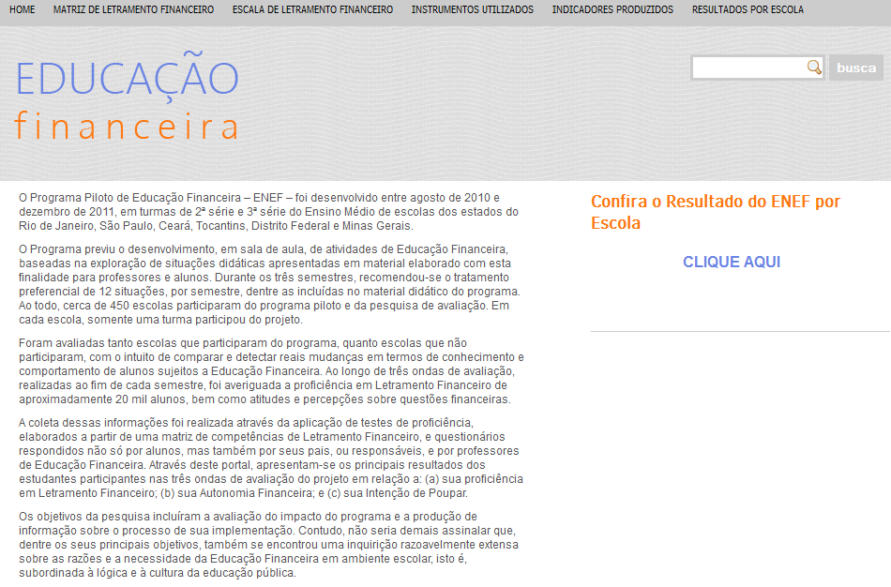
Dissemination of results at school level

Slide 31
What’s the Policy Impact?
The Ministry of Education is now scaling up the program to 5,000 Brazilian high schools
Financial education programs for primary schools
Virtual platform for national dissemination
Development of guidances to disseminate in public and private schools
Educational community of practice for the engagement and exchange of experiences between teachers

Slide 32
Thank you!
More information about the Brazilian Financial Education Program: Silvia Morais silvia.morais@aefbrasil.org.br

