Slide 1
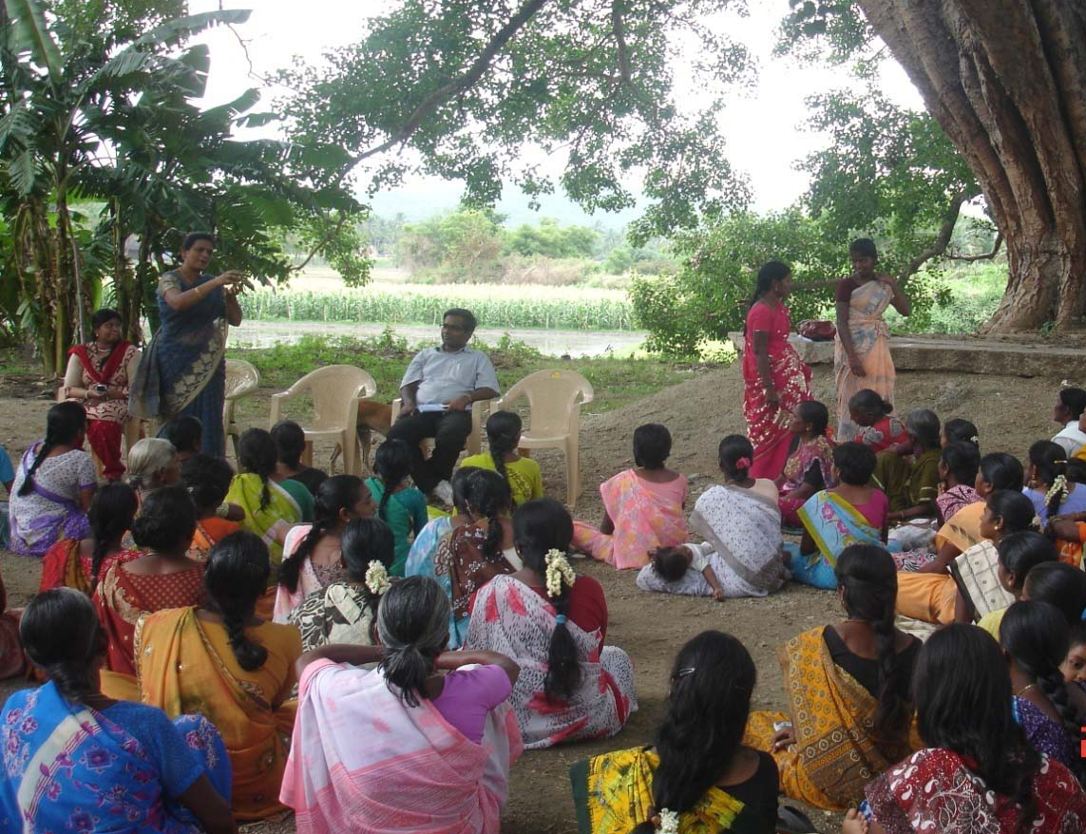
The National Strategy for Financial Education - India
G. P. Garg

Slide 2
Agenda
Background - National Strategy for Financial Education (NSFE)
Development of NSFE document
Benefits envisaged from NSFE implementation
Vision, Mission and Goals of NSFE
Action Plan for Implementation
Stakeholders involved
Components of Financial Education
Delivery Channels
Institutional Arrangement for Implementation
Course of Action in near future

Slide 3
National Strategy for Financial Education (NSFE)
To strengthen and institutionalize the mechanism for maintaining financial stability and enhancing inter-regulatory coordination, an apex-level Financial Stability and Development Council (FSDC) was set-up in 2010
FSDC is chaired by Honorable Finance Minister of India
The sub-committee of FSDC is chaired by the Governor, Reserve Bank of India
A Technical Group has been set up by the sub-committee of FSDC on Financial Inclusion and Financial Literacy
Notes:
3

Slide 4
Development of NSFE Document
The Technical Group on Financial Inclusion and Financial Literacy is headed by Dr. K. C. Chakrabarty, Deputy Governor, Reserve Bank of India
Technical Group comprises of representatives from various Ministries of Government of India, all Financial Sector Regulators and Education Boards
A smaller group was formed including representatives from RBI, SEBI, IRDA and PFRDA to draft the NSFE document
The group consulted OECD-INFE principles and studied the experiences of other countries in similar initiatives
The group also did a study on the course curriculum of various educational boards and various channels available for education in India
After further discussions with various stakeholders, the NSFE document was drafted and the draft was placed on the websites of regulators for public comments
NSFE document was also sent to OECD-INFE for peer review

Slide 5
Benefits envisaged from NSFE
Inclusive Growth, Financial Inclusion and Financial Education
Knowledge and Skill
Freedom from Exploitation
Avoidance of over-indebtedness
Promoting Entrepreneurship
Positive Spill-over effects
Behavioral Change
Deeper participation in Financial Markets

Slide 6
Vision and Mission of NSFE
Vision:
Building a financially aware and empowered India
Mission:
To undertake massive Financial Education campaign to help people manage money more effectively to achieve financial well being by accessing appropriate financial products and services through regulated entities with fair and transparent machinery for consumer protection and grievance redressal

Slide 7
Objectives / Goals of NSFE
Create awareness and educate consumers on access to financial services, availability of various types of products and their features
Change attitudes to translate knowledge into behavior
Make consumers understand their rights and responsibilities as clients of financial services
Notes:
7

Slide 8
Action Plan for Implementation
Strategic Action Plan to be executed in the five year period includes:
Setting up the structure as envisaged in the NSFE document
Incorporating basic financial education in school curricula up to senior secondary level
Creating awareness about consumer protection and grievances redressal machinery available in the country
Delivering Financial Education through trained persons in a format suitable to each target group
Undertaking various measures through stakeholders which includes NGOs, civil society and by using different channels of mass communication
Establishing initial contact with 500 million adults, educating them on key saving, protection and investment related products so that they are empowered to take prudent financial decisions

Slide 9
Stakeholders
Financial Consumers - Individuals resident in India
Financial Market players - banks, non-banking financial companies, mutual funds, pension funds, insurance companies etc and Financial Institutions intermediaries such as brokers, depositories, exchanges, etc
Educational Institutions
Non Governmental Organizations
Financial Sector Regulators
Government- both Central and State
Multilateral international players like OECD, G-20, INFE, etc

Slide 10
Components of Financial Education
Basic Financial Education
Consists of fundamental tenets of financial well being
Delivered through – Schools, Employers, NGOs, etc
Sector Focused Financial Education
Consists of basics of Stock Exchange mechanism, Clearing & Settlement Mechanism, Net-Banking, Loans & guarantees, Life & Non- Life Insurance, etc
Delivered through – Financial Sector Regulators and Intermediaries
Product Education
Consists of educating the consumer about various products available
Target Groups – School Children, Employees, Home makers, etc
Target Groups – Actual & Potential Investors in the Financial Market Segments
Target Groups – Consumers of Financial Products especially at the Point of Sale
Delivered through – Industry Associations (IBA, AMFI, FIMMDA, FEDAI, etc), Manufacturers of Financial Products, Regulators, etc

Slide 11
Delivery Channels
School Curriculum
Social Marketing
Resource Persons
Adult Education
Self-Help Groups
Micro Finance Institutions
Integrated Communication Channels
Helpline
Other Channels such as Consumer Associations, Investor Associations, etc

Slide 12
Institutional Arrangements
The Technical Group on Financial Inclusion and Financial Literacy will be responsible for periodic monitoring and implementation of NSFE
Centre for Financial Education (CFE) will be a specialized centre under National Institute of Securities Markets (NISM)
Representative of Financial Sector regulators will be part of the CFE
Financial Sector regulators will provide funds and manpower to CFE for implementation of NSFE

Slide 13
Course of Action in near future
National Survey to assess the state of Financial Inclusion and Financial Literacy in India
Development of Financial Education website
Development of content for various target groups envisaged
Inclusion of financial education material in School Curriculum
Delivery of financial education through trained resource persons and intermediaries across India

Slide 14
Thank you
Email: gpg@sebi.gov.in / registrar@nism.ac.in

