Slide 1
Measuring Financial Capability:
Lessons Learned from the Papua New Guinea Financial Capability Pilot Study
Ms Rufina Peter, PNG Institute of National Affairs & Bank of PNG
Ms Wei Zhang, The World Bank
Reserve Bank of India-OECD-World Bank
Regional Conference on Financial Education
New Delhi, India
March 4-5 2013

Slide 2

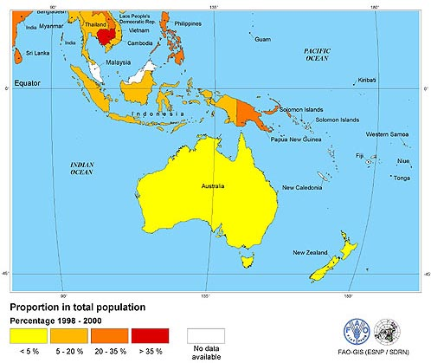
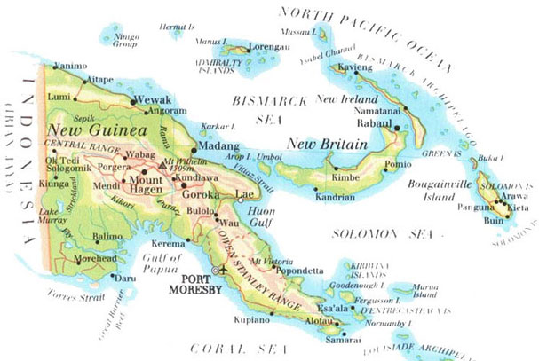
Papua New Guinea

Slide 3
Background
Largest economy in the Pacific:
  Pop: 7 million (2011)
  GDP per capita: US$1,800 approx. (2011)
  Currency: PG kina
Unique challenges and opportunities
  PNG has the greatest linguistic diversity of any country in the world
  PNG has one of the most challenging geographies in the world
  87% of PNGs Population live in rural areas
  PNG combines remote communities in at various stages of adaptation to modernity with highly advanced technology platforms and increasing industrialization and rapid urbanization
  PNG has two economies:
    formal sector (about 20%)
    large informal sector (80%) mainly rural
  PNG has very high levels of financial exclusion (est. 80%)

Slide 4
Status of Financial Inclusion in PNG
  BPNG mandated to lead Financial Inclusion Initiatives in the country
Excess liquidity in banking sector potential to expand financial services to the unbanked
The telecom services has grown significantly in the last 5 years
PNG has a National Financial Inclusion Strategy under development
PNG has an Informal Economy Policy 2011-2015
PNG Participates in several Pacific Regional Initiatives
PNG has committed to the 2020 Money Pacific Goals

Slide 5
Project Overview
Purpose:
To participate in the development of a multi-country instrument to measure financial capability.
To ensure policy relevance in PNG context
Stage1:
  Focus Groups: Nov 2010 - March 2011
  Depth Interviews : June 2011
Stage 2:
  Finalisation of survey instrument: Aug 2011 - January 2012
  Translation into two commonly spoken lingua franca (Tok Pisin and Hiri Motu): January - April 2012
  Pilot Testing and validation of survey instrument: June 2012

Slide 6
Focus Groups
Objective:
To develop a comprehensive and nuanced picture of money related activities undertaken by low income households in PNG
Three (3) locations were selected to conduct focus groups
Eight (8) gender specific focus groups were held encompassing typical low income urban and rural household income modalities
68 people, equal numbers of male & female participants and rural and urban participants,
Activities discussed spanned:
  income generation, expenditure management, inward and outward payments, Remittances, saving (both long and short term), Borrowing, planning and budgeting, seeking financial advice
Notes:
2.1.1 Talai Settlement
• A settlement within Port Moresby city and 10-15 minutes drive from INA Office
• Families of early settlers (specific ethnic groups) have now reached their second
and third generations in the settlement
• With the rapid rate of population growth in the settlements, the Talai Settlement
currently accommodates people from several different ethnic groups in PNG.
• The population of Talai Settlement is more than 20,000 people.
• Focus group respondents were largely from two provinces; the Gulf Province and
the Eastern Highlands Province
• The nearest banking outlet, PNG Microfinance Ltd, is situated less than a 1 km or
5 minutes by bus or car from the settlement.
2.1.2 Galley Reach Rubber Estate
• Situated 76 kilometres northwest of Port Moresby along a major highway
(Hiritano Highway) with good sealed road. Time taken to travel to the site is
approximately 1 hour.
• Population of Galley Reach Estate is about 3000-4000 people.
• Employs people from all over PNG, but predominantly people from the highlands
region as rubber tappers, security, general laborers, administration staff, etc.
• The nearest banks are in Port Moresby City
2.1.3 Cloudy Bay
• Situated approximately 268 kilometres south east of Port Moresby.
• A 6 hours drive from Port Moresby along a major highway (Magi Highway) with
a good sealed road for approx. 4.5 hours of the journey and 1.5 hours travel ‘on
all weather’ unsealed road which is highly susceptible to flooding during the wet
season.
• The residents are largely people from that area only
• He nearest bank is in Port Moresby City

Slide 7
Focus Groups – Lessons Learned
Recording and transcription
Moderation
Relationship between Financial Capability and wellbeing of the household.
Men acknowledging that women were better manages of household finances and women and women stating that men controlled how household finances were used.
Need to interview male and female (usually husband and wife) to get the total picture

Slide 8
Depth Interviews
Purpose:
To develop the set questions for the quantitative survey
Topics were derived from the issues raised by participants in the focus groups
The draft questions for the depth interviews were provided by the Expert Panel (European) team developing the survey instrument
Two rounds of interviews were planned
Due to issues of translation and relevance of survey questions, the PNG team only completed the first round of depth interviews

Slide 9
Depth Interviews - Lessons Learned
It became evident that:
It is not possible to use questions relevant for an environment of high financial inclusion in an environment of low financial inclusion
There is no point in asking questions which are not relevant to the PNG context (for example retirement provision)
It is important to include questions which are relevant to PNG (for example household management of multiple income sources)
Construct validity was a significant issue:
  The questions had been drafted in a language which had many money related constructs (English)
  It proved very difficult to translate to a language (Tok Pisin) with fewer money related constructs
  It is very difficult to translate psychological questions to a trading language which is not intended to convey psychological constructs

Slide 10
Survey Instrument
The third phase of the project was the development and piloting of the quantitative survey instrument
The project was seeking to develop a common instrument which could be used across countries and which would provide a basis for cross-country comparison of financial capability (and the subsequent development of an Index)
The survey focussed on respondents’ behaviour, rather than financial knowledge (there was no option to answer ‘don’t know’). In the context of a developing country this may not be appropriate as knowledge may be a significant barrier to participation (and the accuracy of answers).

Slide 11
Survey Instrument - Lessons Learned
It is very difficult to develop a single comprehensive survey instrument which can measure most/ all facets of financial capability, and which can be used in both highly sophisticated fully monetised economies and monetising economies
The survey instrument was very long (approx. 100 pages) for an interviewer administered survey
There were sections of the survey which were not relevant for low income households in PNG
There was, possibly, inadequate focus on financial knowledge. All questions should include ‘don’t know’
Some information (for example, classifying households by income strata) was not possible due to the lack of formal data (e.g. HIES)
Nevertheless the survey was successfully piloted

Slide 12
Translation - Lessons Learned
The wording of questions must have regard for the language(s) the questions will be translated into
As previously noted construct validity proved to be a very significant issue:
  The survey questions had been drafted in a language which had many money related constructs (English)
  It proved very difficult to translate some questions to a language (Tok Pisin) with fewer money related constructs
  It was very difficult to translate psychological questions to a creole (Tok Pisin) which was not developed to convey psychological constructs. Psychological questions were dropped from the survey
It had been intended to pilot in both Tok Pisin and Hiri Motu. The translation to Hiri Motu proved even more complex than the translation to Tok Pisin. The survey was not piloted in Hiri Motu

Slide 13
Field work (Sampling, enrolment and interviews)
Purposive sampling was used for the pilot to determine if the instrument differentiated between high and low income households
  High and low income census units were selected
  Separate high and low income proxies were developed
Enrolment was undertaken by the National Statistics Office specialist enrolment staff, supported by PNG Project Team. This was a separate activity to interviewing and was successful
Interviews undertaken by experienced NSO enumerators, supported by PNG Project Team. This was successful
  Intensive interviewer training was provided prior to pilot – using both the English language and Tok Pisin versions of the survey. Some interviewers experienced issues with a number of the financial terms
A total of 90 interviews were undertaken (HI-42 households) and (LI-48 households). Interviews conducted at respondents homes and a Central location respecitvely. This was successful

Slide 14
Field Work – lessons learned
Overall the field work for the pilot was successful
Enrolment should be a separate activity to the conducting of the interviews
Use of a (long) paper based survey is not optimal. The risk of error is high:
  Incorrect answers
  Incorrect skips
  Coding errors (when keying)
Screen based data collection would have been preferable
Interviewers must be familiar with the constructs being surveyed – careful attention must be paid to training interviewers in respect to both the survey and the objective of the questions

Slide 15
Survey Pilot – Sample
There was little difference in household composition between low and high income households:
 | Low Income | High Income
 | Mean | Mean
Number of household members | 8.17 | 8.13
Number of adults | 4.46 | 4.61
Number of males | 4.06 | 4.24
Number of females | 4.1 | 3.61

Slide 16
Survey Pilot – Preliminary Findings
The income based impact of limitations in planning capability is evident in the difficulty low income households have in cash flow management and borrowing, which are not offset by higher levels of financial discipline.
 |  | Low Income | High Income
Planning | Plan how money will be used? | 88% | 88%
 | Plan exactly how you will use the money | 25% | 29%
 | Keep to the plan | 50% | 44%
Cash Flow Management | Have money left over after have paid for necessary items | 73% | 88%
 | Run short of money for food or other necessary items | 94% | 68%
 | Use credit or borrow money to buy food or necessary items | 67% | 61%
 | Have to borrow money to pay off debts | 23% | 12%
 | Know how much money spent last week? | 56% | 80%
Borrowing | Could afford to borrow more if wanted or needed to | 4% | 20%
 | Have borrowed to limit | 19% | 20%
 | Have borrowed more than can really afford | 8% | 2%
Financial discipline | I am very disciplined when it comes to managing money. | 58% | 49%
 | I learn from the mistakes other people make managing their money. | 81% | 88%
 | Spend money on things that know are not necessary before spend on necessary items | 58% | 63%
 | Buy things even though know can't afford them? | 44% | 59%

Slide 17
Survey Pilot – Preliminary Findings (cont.)
Responses in respect to ability to meet major expenses also indicate differentiation, higher income households demonstrate a greater ability to meet major expenses:
 |  | Low Income | High Income
Able to cover known major expense in next 12 months | Yes | 25% | 49%
 | No | 41% | 49%
 | Not Answered | 34% | 2%
Done something to make sure will be able to cover expected expense |  | 53% | 44%
Taken action to ensure could meet major unexpected expense (which could not pay in full) |  | 21% | 40%

Slide 18
Conclusions: Did it work?
Preliminary analysis indicates the instrument was successful in describing financial capability and differentiating between low and high income respondents
As stated above, there is a question as to whether it is possible to develop a single instrument to comprehensively measure financial capability across very divergent levels of monetisation
Caution must be exercised when translating abstract questions to a language that does not have similar or comparable constructs
Nevertheless, we conclude the survey could be successfully deployed in PNG to English and Tok Pisin speaking communities.

Slide 19
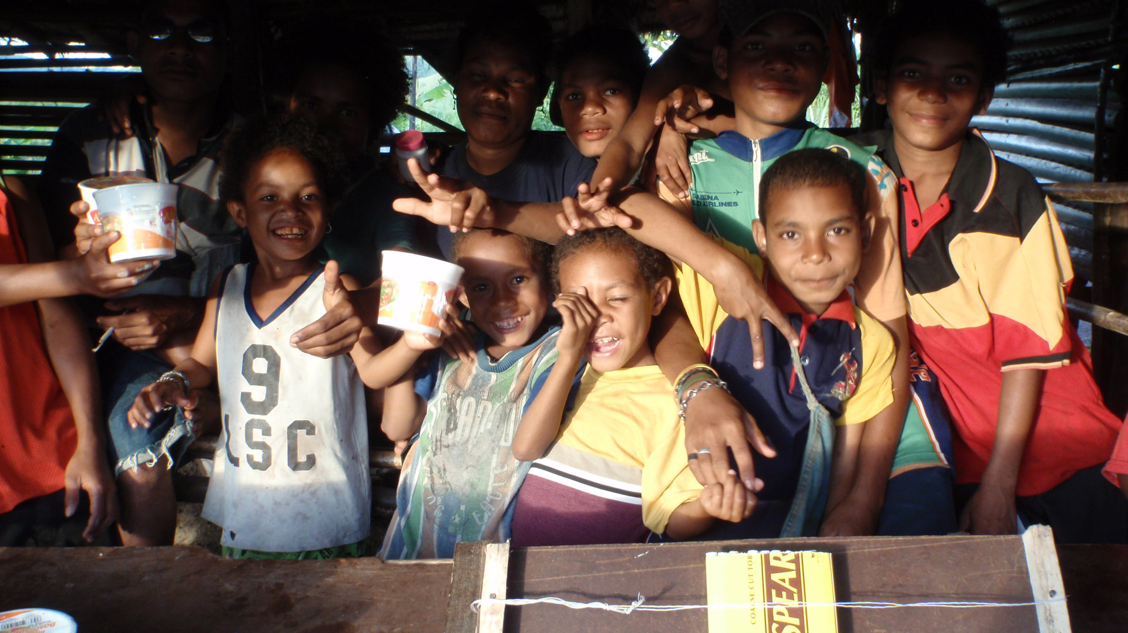
Thank you!

